Slide 2
What is Text-a-Tip?
Youth-focused, 24/7 crisis hotline
Available for anyone in need of emotional support, at any time.
Response from a live, licensed mental health counselor in under 3 minutes
All messages are sent using SMS number masking technology that keeps the communication and your identifying information completely anonymous
Not only for concerns about yourself, but can text out of concerns for friends or loved ones

Slide 3
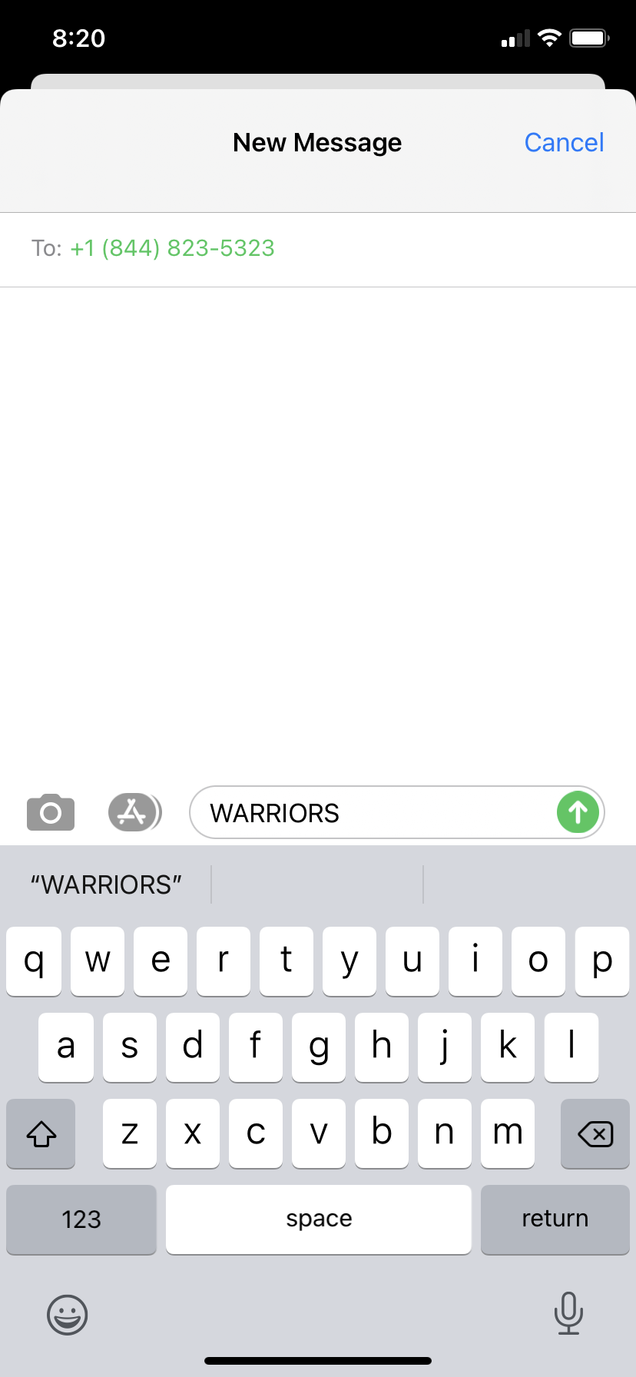
How do you use Text-a-Tip?
Text-a-Tip Steps
Program the Crisis Hotline # (1-844-823-5323)
into your cell phone
Text our school keyword (WARRIORS) + your
Message to the Crisis Hotline #
Licensed Mental Health Counselor will
respond in less than 3 minutes

